Slide 1

Insuresafe –AI Powered Policy Recommendation and Customer Service Portal
Group No. 3
Avadhoot Virkar - 22107064
Chinmay Pawaskar – 22107066
Atharva Nimkar – 22107025
Project Guide
Ms. Poonam Pangarkar

Slide 2
Contents
Abstract
Introduction
Objectives
Literature Review
Research Gap
Problem Definition
Scope
Technological Stack
Proposed System Architecture/Working/Module Diagram
Prototype Design Demonstration

Slide 3
Abstract
The insurance industry faces challenges such as lack of personalized recommendations, slow verification processes, and increasing fraud. To address this, Insuresafe – AI Powered Policy Recommendation and Customer Service Portal is developed as an intelligent solution. It automates key insurance operations using AI and smart system logic. The platform includes a Policy Recommendation Engine that suggests suitable plans based on user data like age, income, and lifestyle. A Facial Verification Module enhances security by matching real-time images with stored data. The Document Verification Module uses OCR to extract and validate Aadhaar details. Additionally, the system includes an AI-assisted claims processing module for faster claim handling. It uses deep learning models like YOLO for vehicle damage detection and fraud analysis. The system can automatically approve, reject, or flag claims. Separate dashboards are provided for customers and administrators for easy management. The platform improves efficiency, reduces manual errors, and enhances fraud detection. Overall, InsureSafe ensures secure, transparent, and personalized insurance services

Slide 4
Sustainable Development Goals(SDG) mapped
SDG 9: Industry, Innovation, and Infrastructure→Leveraging AI and facial verification reflects innovation in financial services infrastructure.
Insuresafe uses smart AI tools like facial recognition and document checking to improve how insurance works. It helps verify people’s identity, suggest the best insurance plans, and speed up claims in a safer and faster way. This makes the insurance system stronger, more reliable, and easier for everyone to use, which supports the goal of building better industries and infrastructure

Slide 5
Introduction
In the current insurance industry, customers face slow and complex processes for policy selection, identity verification, and claim approval. While existing solutions provide online access to policies and claims, they still require heavy manual verification, are prone to fraud, and lack personalized recommendations. These persisting issues highlight the need for a secure, automated, and user-friendly platform that combines advanced AI features to improve efficiency and trust.
Motivation
Frequent cases of fake documents and fraudulent claims observed in the insurance market.
Current verification systems rely heavily on manual checks, leading to delays and human errors.
Growing demand for AI-driven, personalized insurance services that save time and reduce risk.

Slide 6
Objectives
To integrate a policy recommendation engine to suggest suitable insurance policies based on user age or income.
To implement facial verification using Deepface to compare a live selfie with the user’s photo for secure identity validation during policy issuance.
To develop a document verification module using OCR and image classification to extract and validate details from uploaded identity documents for compliance and fraud detection.
To create an AI-assisted claims processing module using YOLO11 to validate uploaded images, detect fraud, and automate claim approvals.

Slide 7
Literature Review
Sr.no | Title | Author(s) | Year | Methodology | Drawback
[1] | Deep Cross-Domain Insurance Recommendation System (DCDIR) | Ye Bi, Liqiang Song, Mengqiu Yao, Zhenyu Wu, Jianming Wang, Jing Xiao | 2020 | Graph-based insurance knowledge feature learning + GRU for user interest modeling + multi-layer perceptron for mapping across domains | Requires large cross-domain datasets; complexity in knowledge graph construction
[2] | Session-Based Insurance Recommendation Model | Simone Borg Bruun, Maria Maistro, Christina Lioma | 2022 | Recurrent neural network trained on user session sequences in insurance domain to recommend policies | Sparse interaction data; limited product variety; complex session modeling
[3] | Accurate and Interpretable ML for Transparent Pricing | Rohun Kshirsagar et al. (Lumiata team) | 2020 | Two-tier model (patient-level & employer-group-level) for prediction, outperforming actuarial models by 20% | High data requirement; restricted to employer-sponsored plans; complex implementation
[4] | Explainable AI-Enhanced Underwriting Automation | Hari Suresh Babu Gummadi | 2025 | XAI-enhanced underwriting using SHAP, ALE, counterfactuals, rule extraction; personalized recommendations | Heavy computational overhead; need for explainable frameworks; integration challenge

Slide 8
Sr.no | Title | Author(s) | Year | Methodology | Drawback
[5] | Machine Learning Recommender for Nigerian Health Insurance | Ayomide Owoyemi, Emmanuel Nnaemeka et al. | 2023 | Content-based recommender using KNN and cosine similarity for HMO selection based on location/prices | Limited to Nigerian context; doesn't address non-location factors
[6] | EfficientFace: An Efficient Deep Network with Feature Enhancement for Accurate Face Detection | Guangtao Wang, Jun Li, Zhijian Wu, Jianhua Xu, Jifeng Shen, Wankou Yang | 2023 | Lightweight CNN with feature fusion and attention for robust face detection | Struggles in highly occluded/low-resource cases; attention adds overhead
[7] | Human Face Recognition Based on CNN and Augmented Dataset | P. Lu, B. Song, L. Xu | 2021 | CNN with augmented training data to improve recognition accuracy | Relies on augmentations; limited generalization to real-world variations
[8] | Document Image Analysis Survey | V. V. Arlazarov, E. I. Andreeva, K. B. Bulatov, D. P. Nikolaev. | 2022 | Broad survey of document recognition techniques: OCR, layout, classification | No empirical baseline; broad coverage, not focused app
[9] | Document Classification via OCR | O. O. Petrova, B. I. Savelev, O. A. Slavin | 2021 | OCR+ML classifier pipeline for document categorization | OCR accuracy dependent on image quality; few real-world evaluations

Slide 9
Sr.no | Title | Author(s) | Year | Methodology | Drawback
[10] | Identity Document Verification Pipeline | Castelblanco et al. | 2020 | Deep learning ML pipeline: segmentation, localization, authenticity classification (~98% accuracy) | Tested on limited Colombian IDs; may not generalize
[11] | ConvNeXt V2 for Document Analysis | Xin, et al. | 2023 | Modern CNN-based architecture for classification of document images | Experimental; not evaluated on insurance document datasets
[12] | Auto Vehicle Claim Processing (CV & NLP) | Fernando et al. | 2022 | Hybrid solution: CNN for damage detection, OCR, plus NLP to extract claim data | Limited domain (vehicle); limited generalization; complex integration
[13] | Medical Insurance Data Analytics w/ DL | (Unir team) | 2023 | CNN pipelines for medical documentation and image analysis in health claims | Domain-specific; generalizability limited
[14] | AI Transformation in Healthcare Claims | ResearchGate authors | 2025 | Survey of NLP, Intelligent Document Processing, automation in claims | Descriptive; lacks experimental results
[15] | Medical Image Analysis Using DL | M. Li and co-authors | 2023 | Survey of deep learning techniques for medical images (transferable to claims) | General healthcare focus; needs adaptation for insurance workflows

Slide 10
Research Gap(Limitations of existing systems)
Manual verification delays – Claims and policy approvals still rely on paperwork and repeated document submissions, slowing the process.
Ineffective chatbots – Automated support often fails to resolve queries, leading to frustration and longer resolution times.
Old systems – Insurance companies often use outdated systems where data is stored separately, making it slow to find and update customer information.

Slide 11
Problem Definition
Difficulty in selecting suitable insurance policies due to lack of recommendations.
Manual verification processes leading to errors and weak fraud detection.
Slow claim settlement and outdated payment methods.
Lack of AI-based tools like OCR, fraud detection, and chatbots.
Complex and non-user-friendly insurance websites.
Need for an intelligent platform to automate processes and improve efficiency.

Slide 12
Scope
Easy Policy Selection – A simple interface with clear language and AI-driven recommendations to help users choose the best policy for their needs.
Secure Identity Verification – Facial recognition and document scanning to confirm user identity quickly and safely.
Fast Document Verification – AI-based OCR and image analysis to check the authenticity of identity documents without manual delays.
Smart Claim Processing – AI tools to analyze claim images/documents, detect fraud, and approve genuine claims faster.

Slide 13
Technological Stack
Frontend Technologies :
HTML5, CSS3, JavaScript
Bootstrap 5.3.7
Backend Technologies :
Python 3.13.1
Flask 3.1.2
MongoDB 1.46.11
Model Used:
Deepface
Optical Character Recognition (OCR)
YOLO11

Slide 14
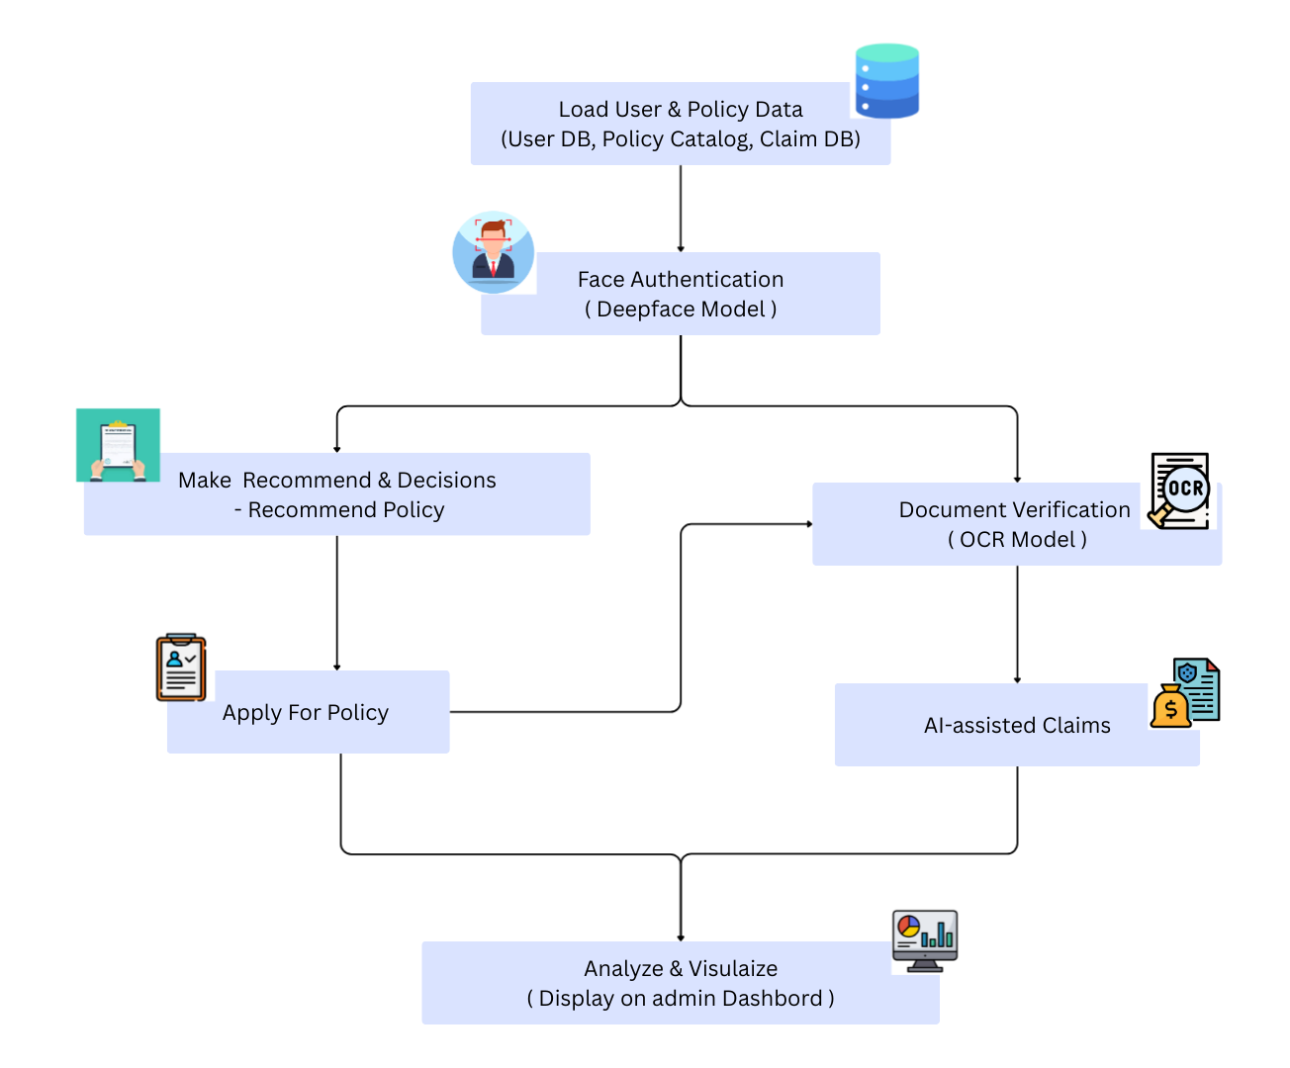
Proposed system architecture/Working/Module Diagram

Slide 15
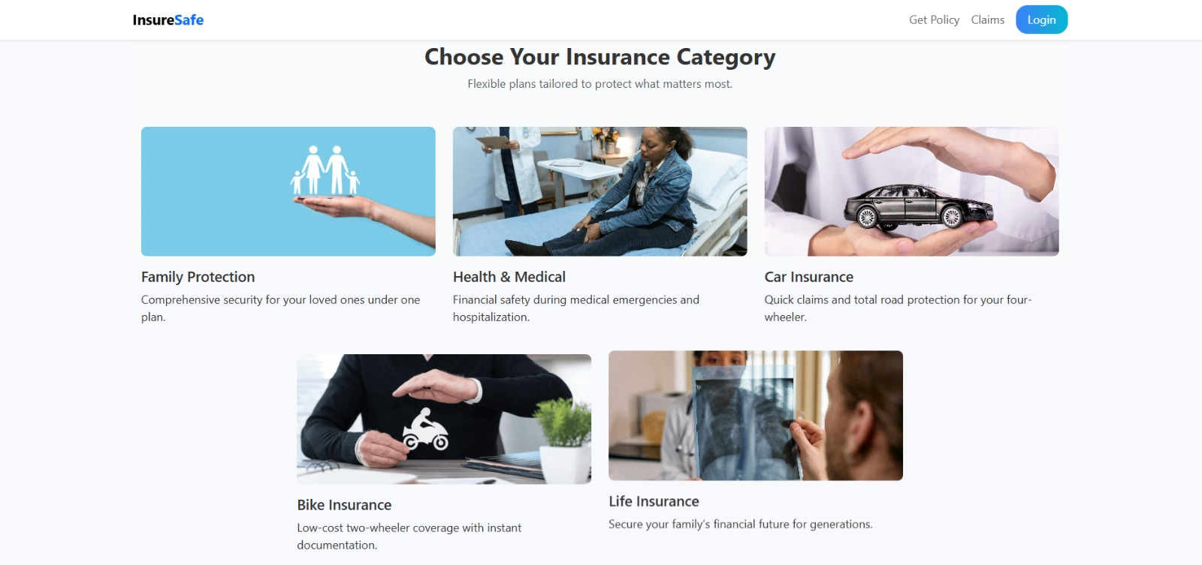
Prototype Design Demonstration
Fig. 1.1: Landing Page

Slide 16
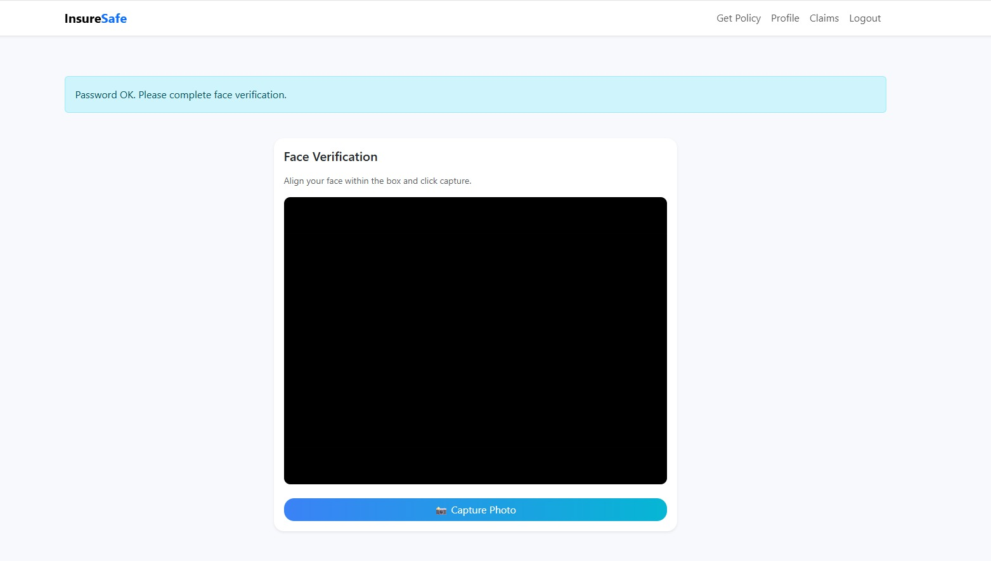
Prototype Design Demonstration
Fig. 1.2: Face Verification

Slide 17
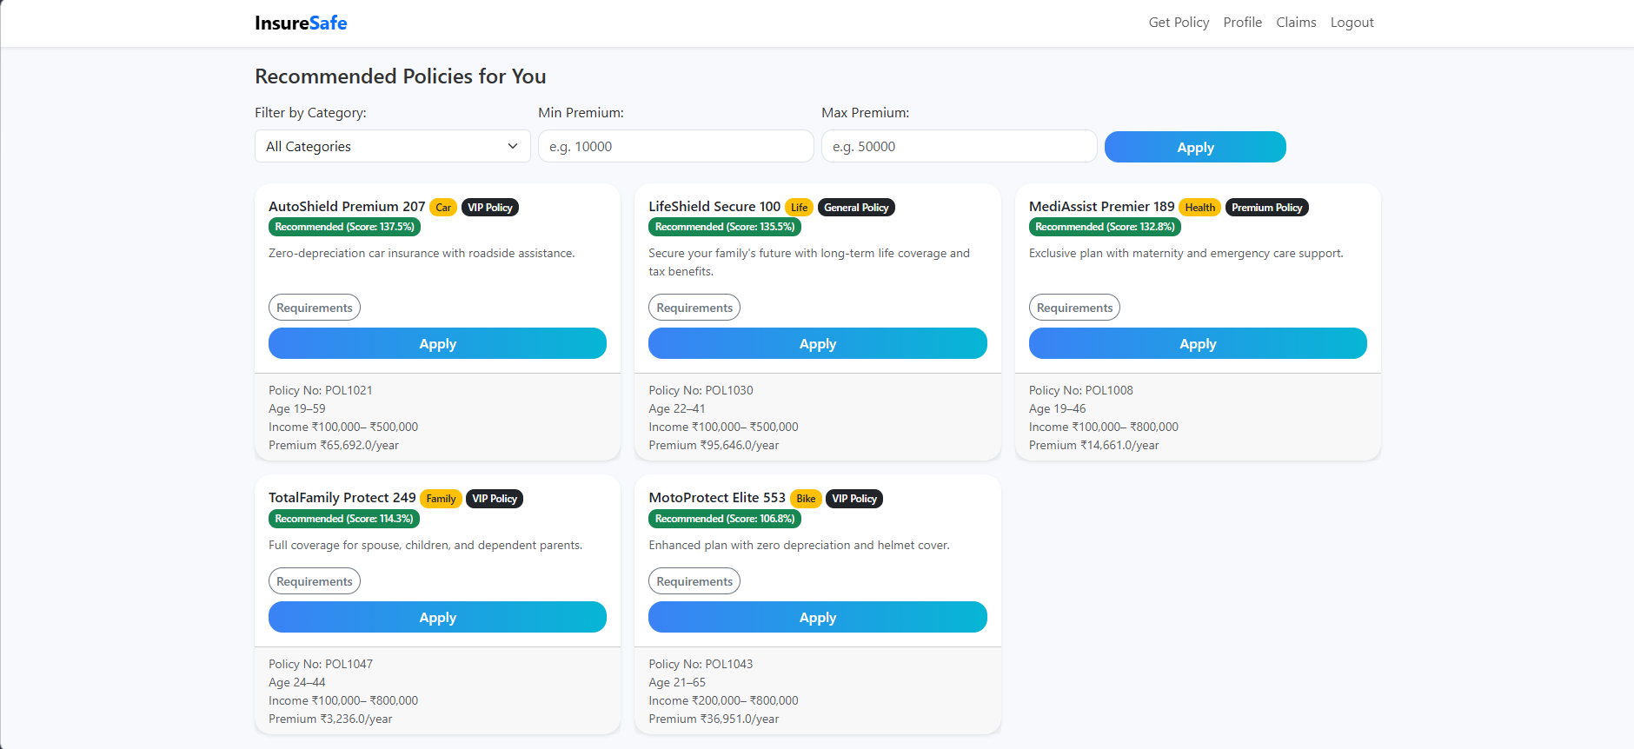
Prototype Design Demonstration
Fig. 1.3 Policies Page

Slide 18
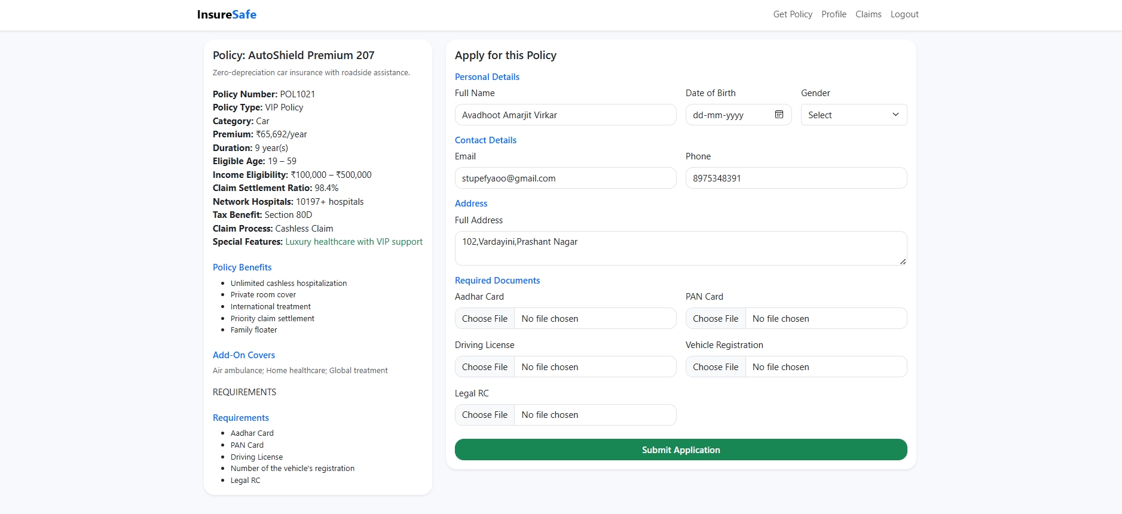
Prototype Design Demonstration
Fig. 1.4: Application For Policies

Slide 19
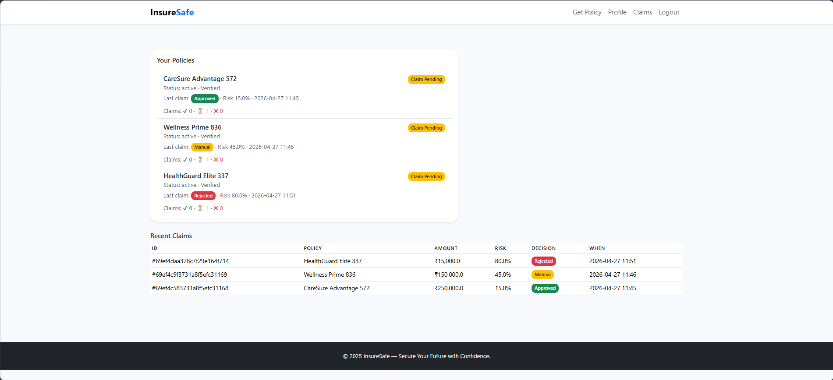
Prototype Design Demonstration
Fig. 1.5: AI Claims

Slide 20
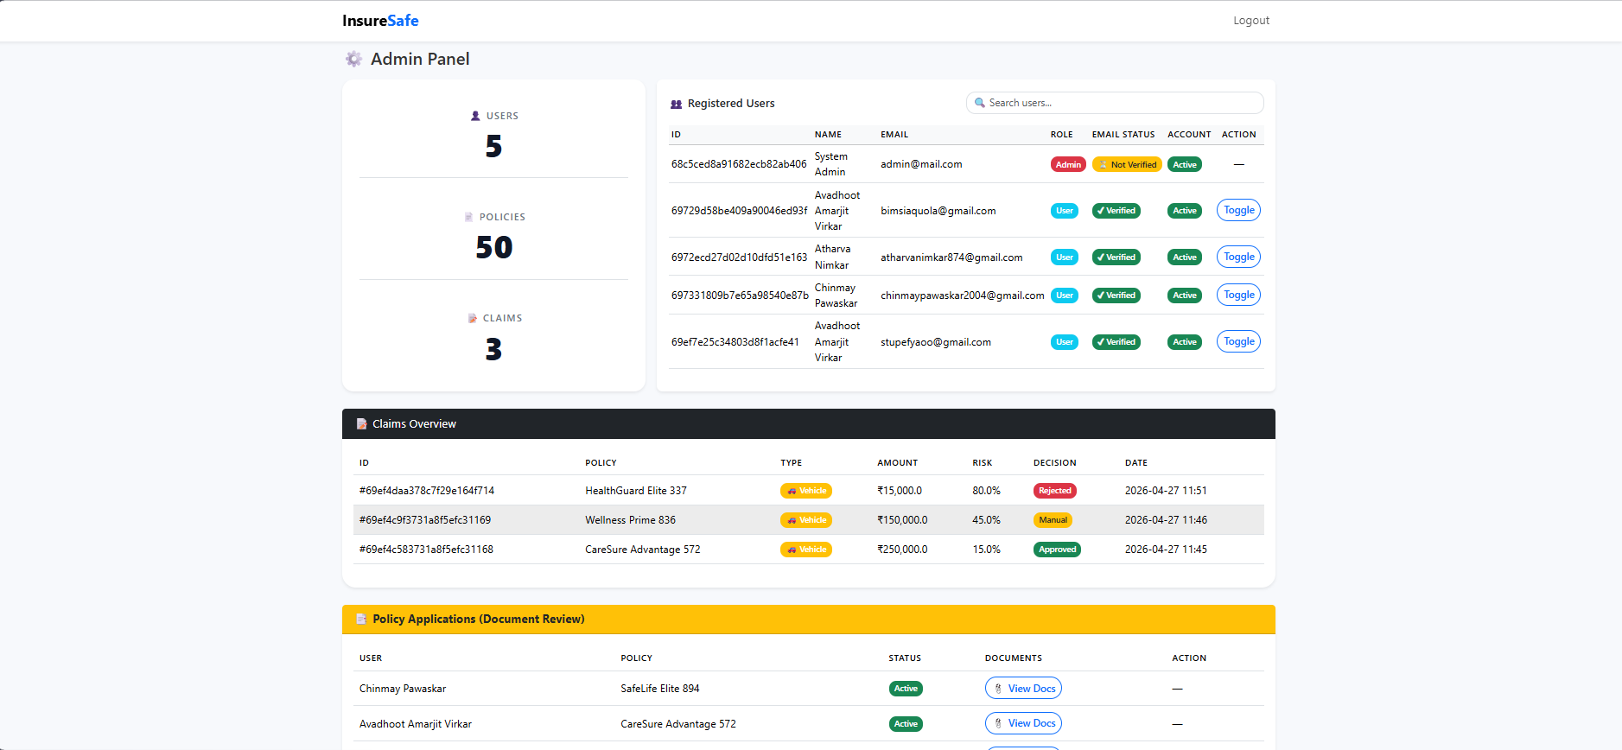
Prototype Design Demonstration
Fig. 1.6: Admin Panel

Slide 21
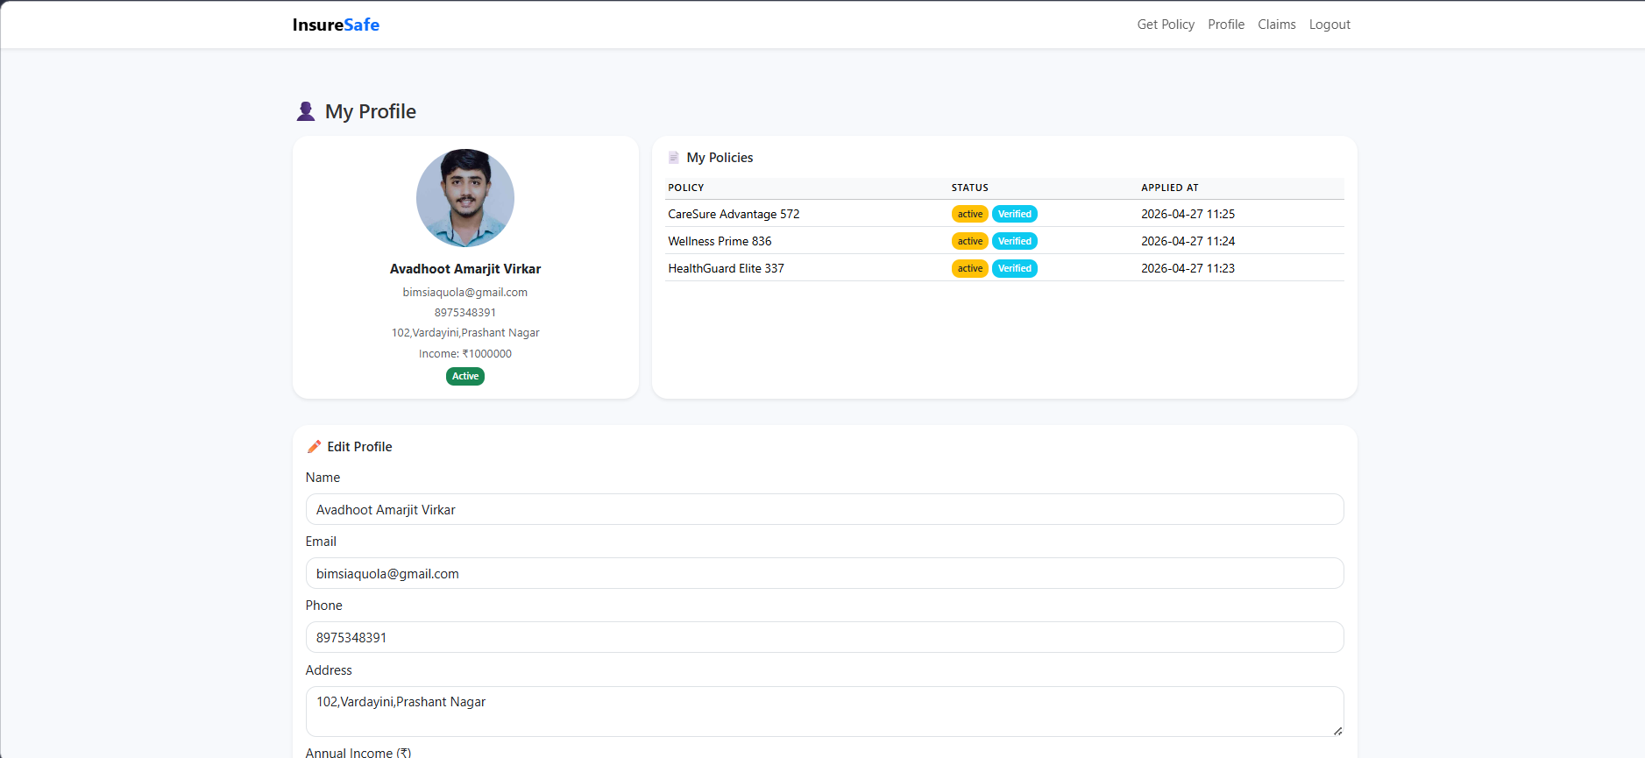
Prototype Design Demonstration
Fig. 1.7: Profile Page

Slide 22
References
A. Al-Azzam, “Recommendation System for Insurance Policies”, Thesis, Diva Portal, pp. 1–67, 2023. Available: https://www.diva-portal.org/smash/get/diva2%3A1768102/FULLTEXT01.pdf .[1].
B. BHUVANESHWARI, GAYATRI DEEPTHI Y., K. KEERTHANA, “Insurance Recommendation System”, International Journal of Innovative Science and Research Technology (IJISRT), vol. 8, no. 3, pp. 1292–1297, 2023. Available: https://ijisrt.com/assets/upload/files/IJISRT23MAR1661_%281%29.pdf https://ijisrt.com/assets/upload/files/IJISRT23MAR1661_%281%29.pdf. [2].
S. Choudhary, R. Singh, and K. Mehta, “Recommendation System for Health Insurance Decision Making”, arXiv preprint arXiv:2305.10708, pp. 1–10, 2023. Available: https://arxiv.org/pdf/2305.10708.pdf.[3].
M. Dutta and P. Saha, “Explainable AI-Enhanced Underwriting Automation for Personalized Insurance Policy Recommendations”, ResearchGate Preprint, pp. 1–12, 2024. Available: https://www.researchgate.net/publication/391681757_Explainable_AI-Enhanced_Underwriting_Automation_for_Personalized_Insurance_Policy_Recommendations [4].
H. Wechsler, J. Phillips, V. Bruce, and T. Huang, “Face Recognition: A Convolutional Neural-Network Approach”, IEEE Transactions on Neural Networks, vol. 8, no. 1, pp. 98–113, 2023. Available: https://clgiles.ist.psu.edu/papers/IEEE.TNN.face.recognition.hybrid.nn.pdf [5].

Slide 23
References
H. Li, Z. Lin, X. Shen, J. Brandt, and G. Hua, “A Convolutional Neural Network Cascade for Face Detection”, in Proc. IEEE CVPR, pp. 5325–5334, 2020. Available: https://openaccess.thecvf.com/content_cvpr_2015/papers/Li_A_Convolutional_Neural_2015_CVPR_paper.pdf [6]
C Lee and Steve Lawrence, “Face Recognition: A Convolutional Neural Network Approach”, ResearchGate, pp. 1–14, 1997. Available: https://www.researchgate.net/publication/3302251_Face_Recognition_A_Convolutional_Neural_Network_Approach [7].
A. Antonacopoulos and D. Karatzas, “Document Image Analysis and Recognition: A Survey”, ResearchGate, pp. 1–20, 2022. Available: https://www.researchgate.net/publication/363252450_Document_image_analysis_and_recognition_a_survey [8]
M. Yadav and R. Tripathi, “Classification of Documents Extracted from Images with Optical Character Recognition”, arXiv preprint arXiv:2106.11125, pp. 1–8, 2021. Available: https://arxiv.org/pdf/2106.11125.pdf [9]
J. Martínez, A. Blanco, and F. Herrera, “Machine Learning Techniques for Identity Document Verification in Mobile Scenarios”, Frontiers in AI (PMC), vol. 3, pp. 1–15, 2020. Available: https://www.ncbi.nlm.nih.gov/pmc/articles/PMC7297568/ [10]

Slide 24
References
N. Patel and S. Jain, “A ConvNeXt V2 Approach to Document Image Analysis”, TechRxiv Preprint, pp. 1–10, 2023. Available: https://www.techrxiv.org/users/807282/articles/1210179/master/file/data/Document_classification_july_10/Document_classification_july_10.pdf [11].
R. Gupta and P. Agrawal, “Automated Vehicle Insurance Claims Processing Using Computer Vision & NLP”, ResearchGate Preprint, pp. 1–9, 2022. Available: https://www.researchgate.net/publication/366185375_Automated_vehicle_insurance_claims_processing_using_computer_vision_natural_language_processing[12].
E. López and M. García, “Deep Learning Assisted Medical Insurance Data Analytics”, International Journal of Interactive Multimedia and Artificial Intelligence (IJIMAI), vol. 8, no. 2, pp. 54–61, 2022. Available: https://reunir.unir.net/bitstream/handle/123456789/14324/ijimai8_2_7.pdf?isAllowed=y&sequence=3 [13].
A. Banerjee and R. Sinha, “AI Transformation in Healthcare Claims Processing: Technical Overview”, ResearchGate Preprint, pp. 1–18, 2025. Available: https://www.researchgate.net/publication/391323743_AI_transformation_in_healthcare_claims_processing_Technical_overview [14].
P. Singh, A. Nair, and L. Zhao, “Medical Image Analysis Using Deep Learning Algorithms”, Frontiers in AI (PMC), vol. 6, pp. 1–16, 2023. Available: https://www.ncbi.nlm.nih.gov/pmc/articles/PMC10662291/ [15].

Slide 25
Thank You...!!

